Slide 1
32KB L-TAGE Branch Predictor Jayson Boubin
Tage predictor:
12 TAGE tables, 1 bimodal table
Each table has from 2^9 to 2^11 entries
Entries are sized from 7 to 15 tag bits, 3 pred bits
Entries are accessed by XORing PC and history bits (from 5 to 640 history bits)
Total size: 237.5KB
Loop Predictor:
512 entries
14 bit tag, 28 other bits
Counter checks to see if the current PC is a loop branch
Clock:
A clock resets the usefulness of all tables every 2^20 branches. This helps limit conflicts between branches that are very far apart.

Slide 2
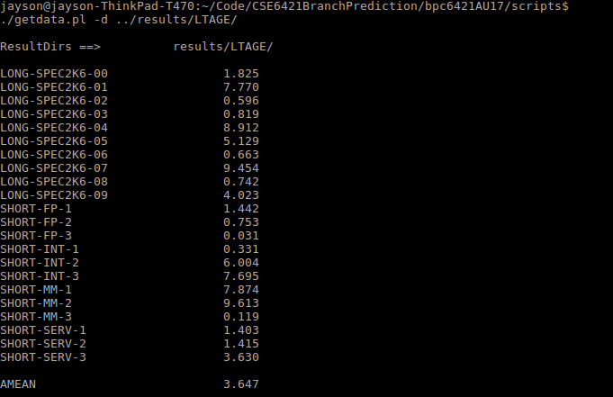
Results
Final AMEAN: 3.647
Optimizations from the original paper:
Clock updates every 2^20 bits, instead of 2^18
History sizes were updated
Loop predictor max age increased from 32 to 256
Loop predictor total size decreased from 1024 to 512
Bimodal table decreased from 2^14 to 2^13 entries
Bimodal table prediction bits increased to 2 bits for all
Sources: L-TAGE: https://www.jilp.org/vol9/v9paper6.pdf
L-TAGE: https://www.irisa.fr/caps/people/seznec/L-TAGE.pdf
PPM: https://www.jilp.org/vol7/v7paper10.pdf

